Slide 1

Faculty Interfolio Information Session
Loyola University Chicago
June 12, 2024

Slide 2
Introductions
Michelle Pencyla, M.Ed.
Assistant Provost, Faculty Administration, Health Sciences Campus Office mpencyla@luc.edu
Julia Elsky, Ph.D.
Associate Director of Faculty Affairs;
Associate Professor, Department of Modern Languages & Literatures
jelsky@luc.edu

Slide 3
Walk Through of SSOM Promotion Process
and Interfolio RPT
• SSOM Promotion Process Timeline
• Introducing Interfolio RPT
• How to access Interfolio RPT and upload materials
• Q & A

Slide 4
Timeline of Important Dates
April 15: The department chair submits the list of faculty going up for promotion and/or tenure
August 1: Completed application packets submitted via Interfolio
December 1: All promotion packets ordinarily will have been reviewed by CART.
If CART Votes are Negative: Chair notified as soon as possible to discuss with the faculty member
December 15: Chairs will ordinarily have been notified of the recommendation by CART.
By March 15: All candidates will ordinarily have been notified by the Provost of the University’s final decision.

Slide 5
SSOM CART Website
Reference materials are located at the SSOM CART Website: https://ssom.luc.edu/cart/
Timeline Memo – Final packet needs to be uploaded by 8/1/24.
Example promotion packet and cover sheet
P&T Guidelines and Addendums
CV Format for SSOM Faculty – make sure PubMed ID included on Bibliography

Slide 6
Important items to keep in mind
Is this an early promotion?
If the number of years at the current rank is less than 5 years as of July 1, 2024, this is considered an early promotion.
This requires the department chair letters, the faculty’s CV and personal statement to contain detail on how the faculty member demonstrated extraordinary effort for consideration for early promotion.
CV Needs to be in the proper format
An example of the SSOM CV format is located at the http://ssom.luc.edu/cart/

Slide 7
Walk Through of Interfolio RPT
• Introducing Interfolio RPT
• How to access Interfolio RPT and upload materials
• Q & A

Slide 8
What is Interfolio RPT?
• Online tool for faculty under review to tell their story
• Enable committees to conduct efficient, fair digital evaluations of faculty
• Provide academic leadership with a consistent source of reliable information about all faculty evaluations
• Faculty Affairs will request that Schools/College send names of faculty who are applying for tenure and/or promotion in late spring/early summer, depending on your School’s promotion timeline. Once we receive those names, we will create Interfolio RPT cases for faculty and notify faculty directly via Interfolio RPT.

Slide 9
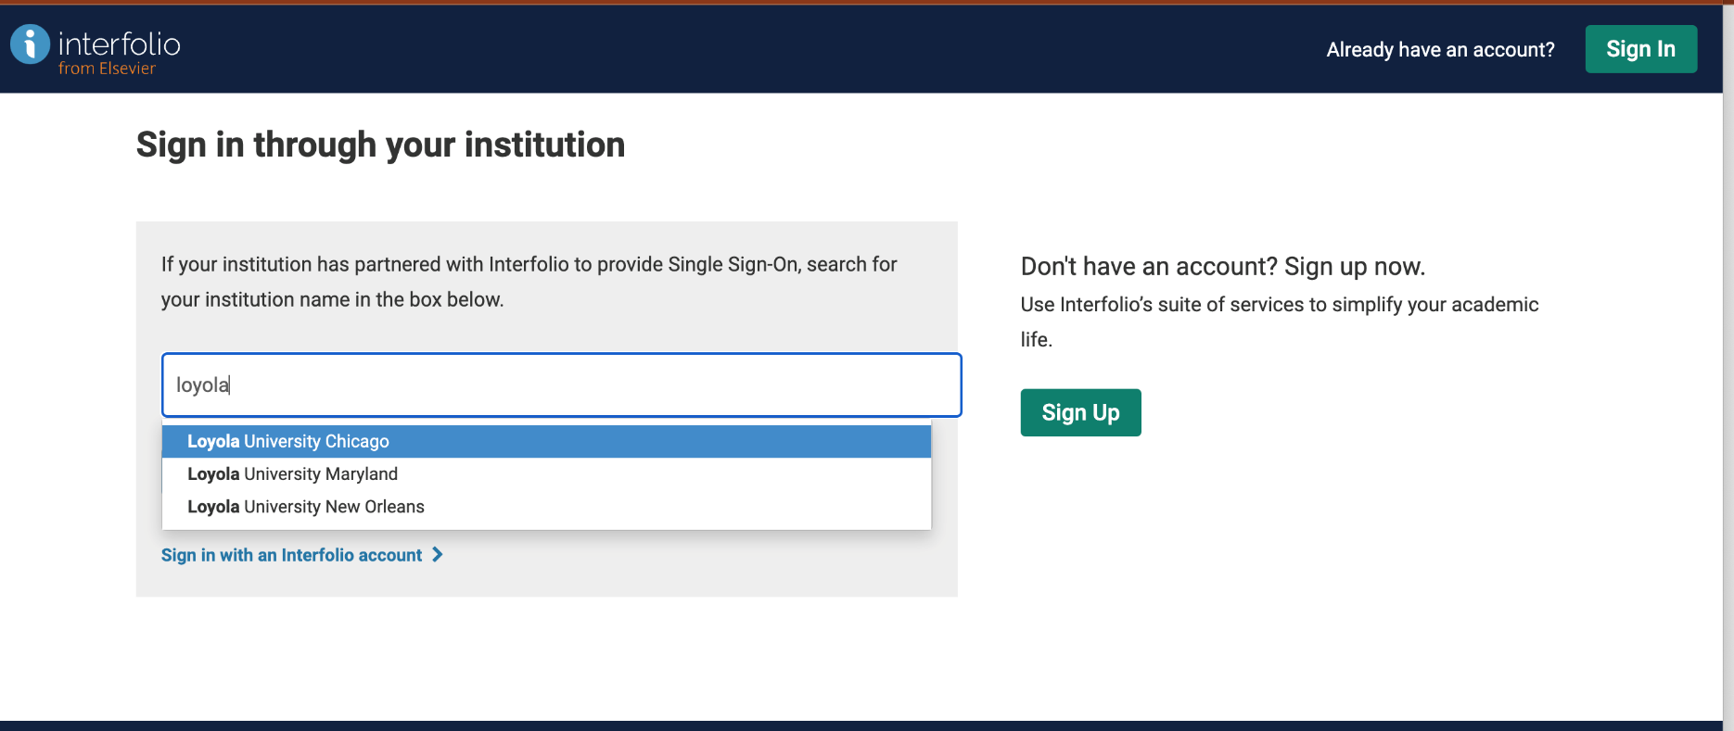
Step 1. Log into Interfolio RPT using your LUC email address

Slide 10
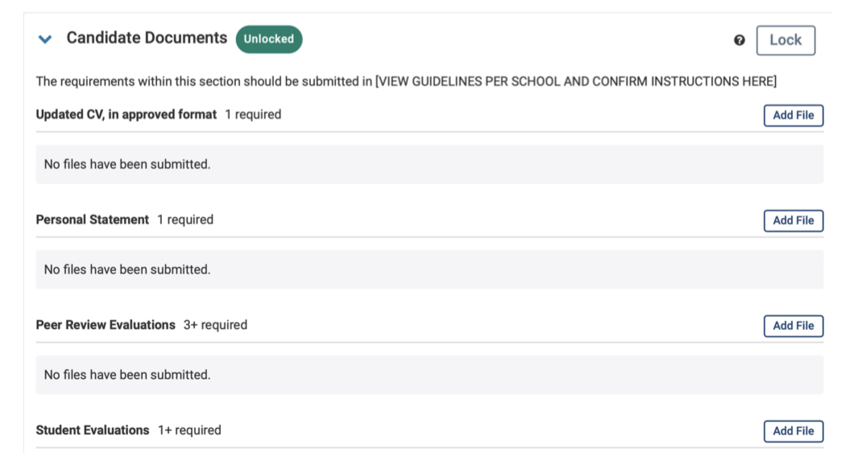
Step 2. Upload Candidate Materials for internal review

Slide 11
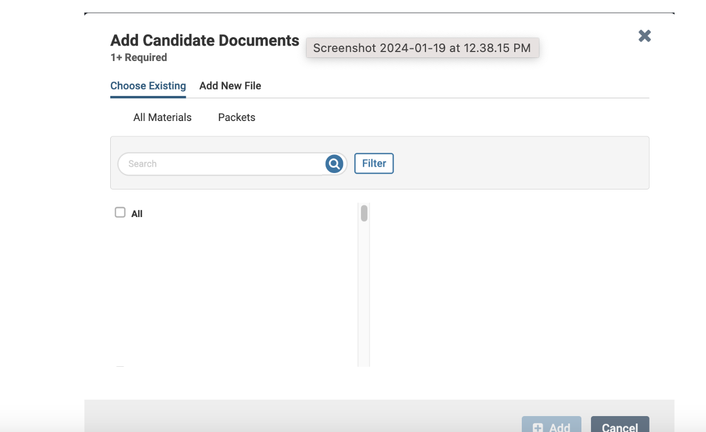
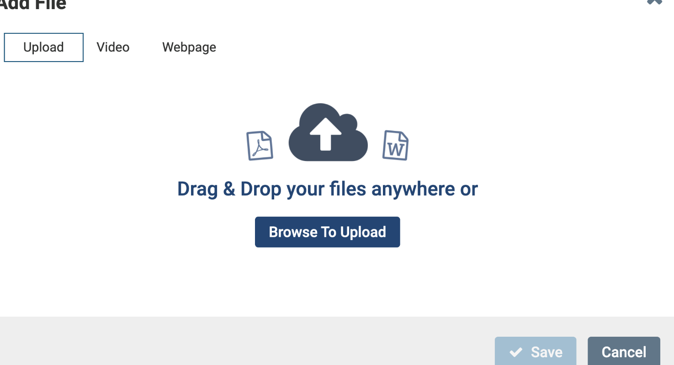
Uploading materials: files

Slide 12
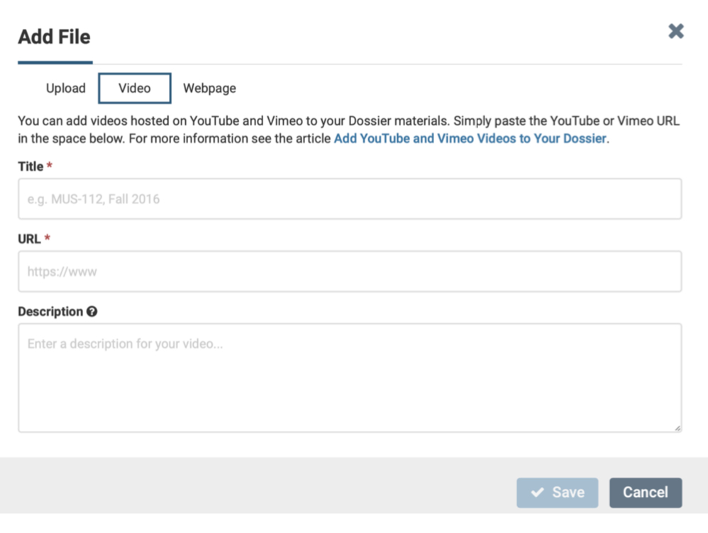
Uploading materials: link to online video

Slide 13
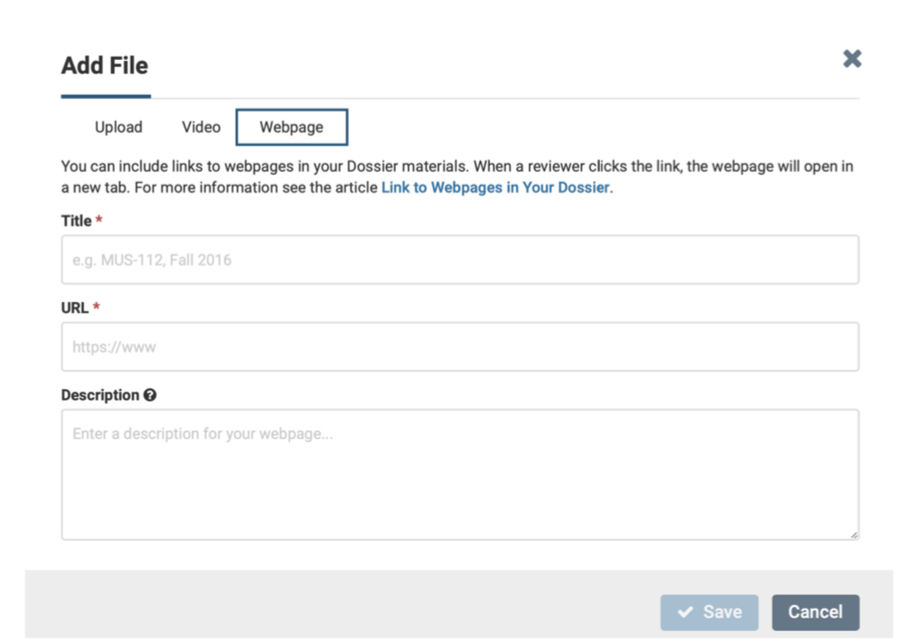
Uploading materials: link to webpage

Slide 14
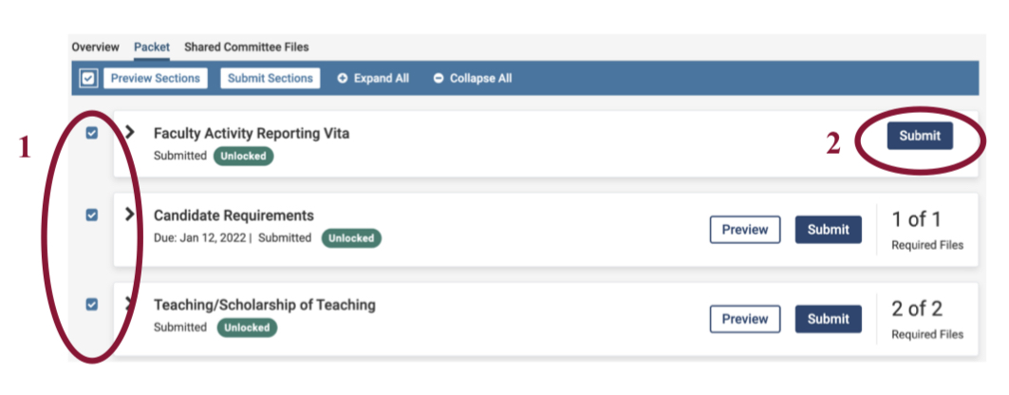
After uploading all materials, submit packet. Click on the checkboxes, then click the Submit button.

Slide 15
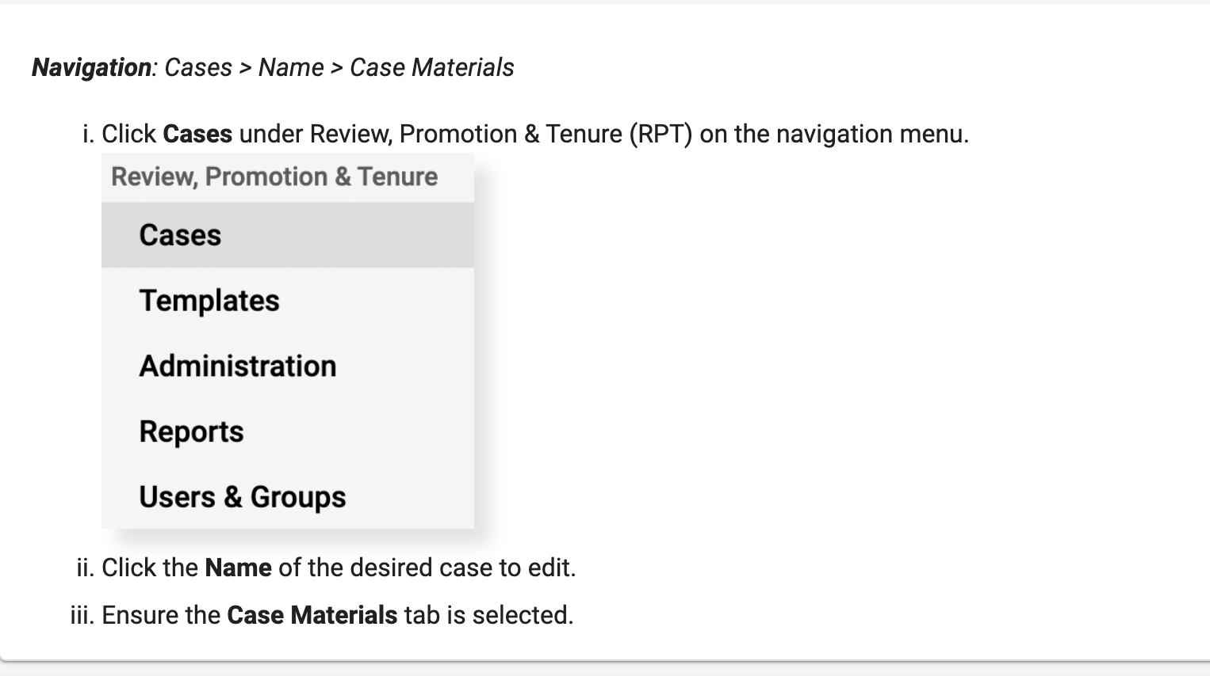
Step 3. Upload confidential internal review files

Slide 16
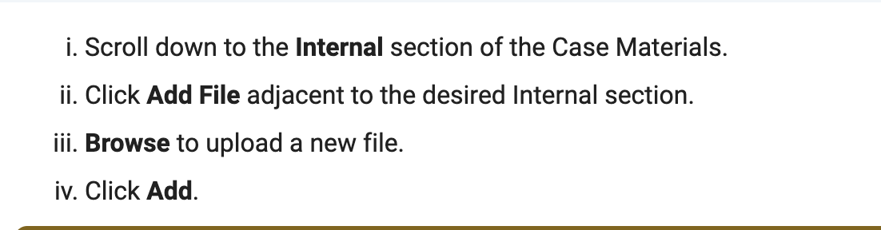
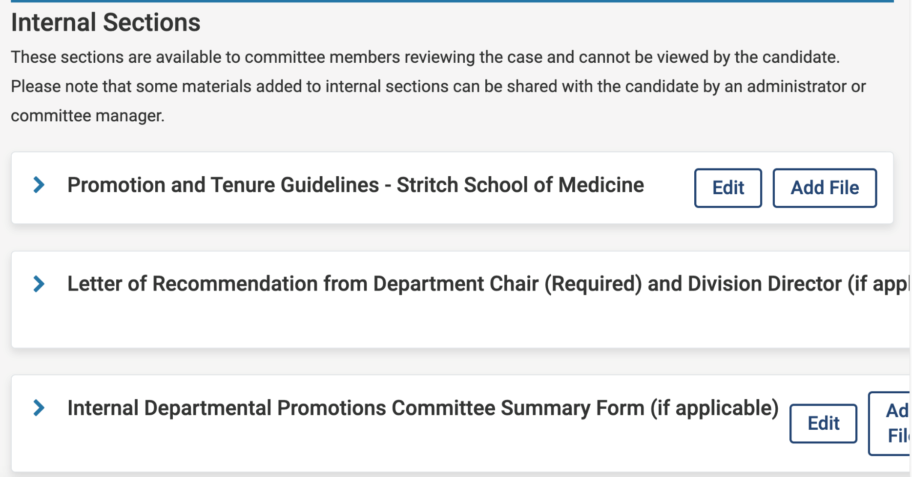

Slide 17
Interfolio RPT Support
For technical support, please contact Interfolio's Support team: help@Interfolio.com or (877) 997-8807
For questions about candidate cases, adding/managing users, and academic unit templates, please contact: mpencyla@luc.edu

Slide 18
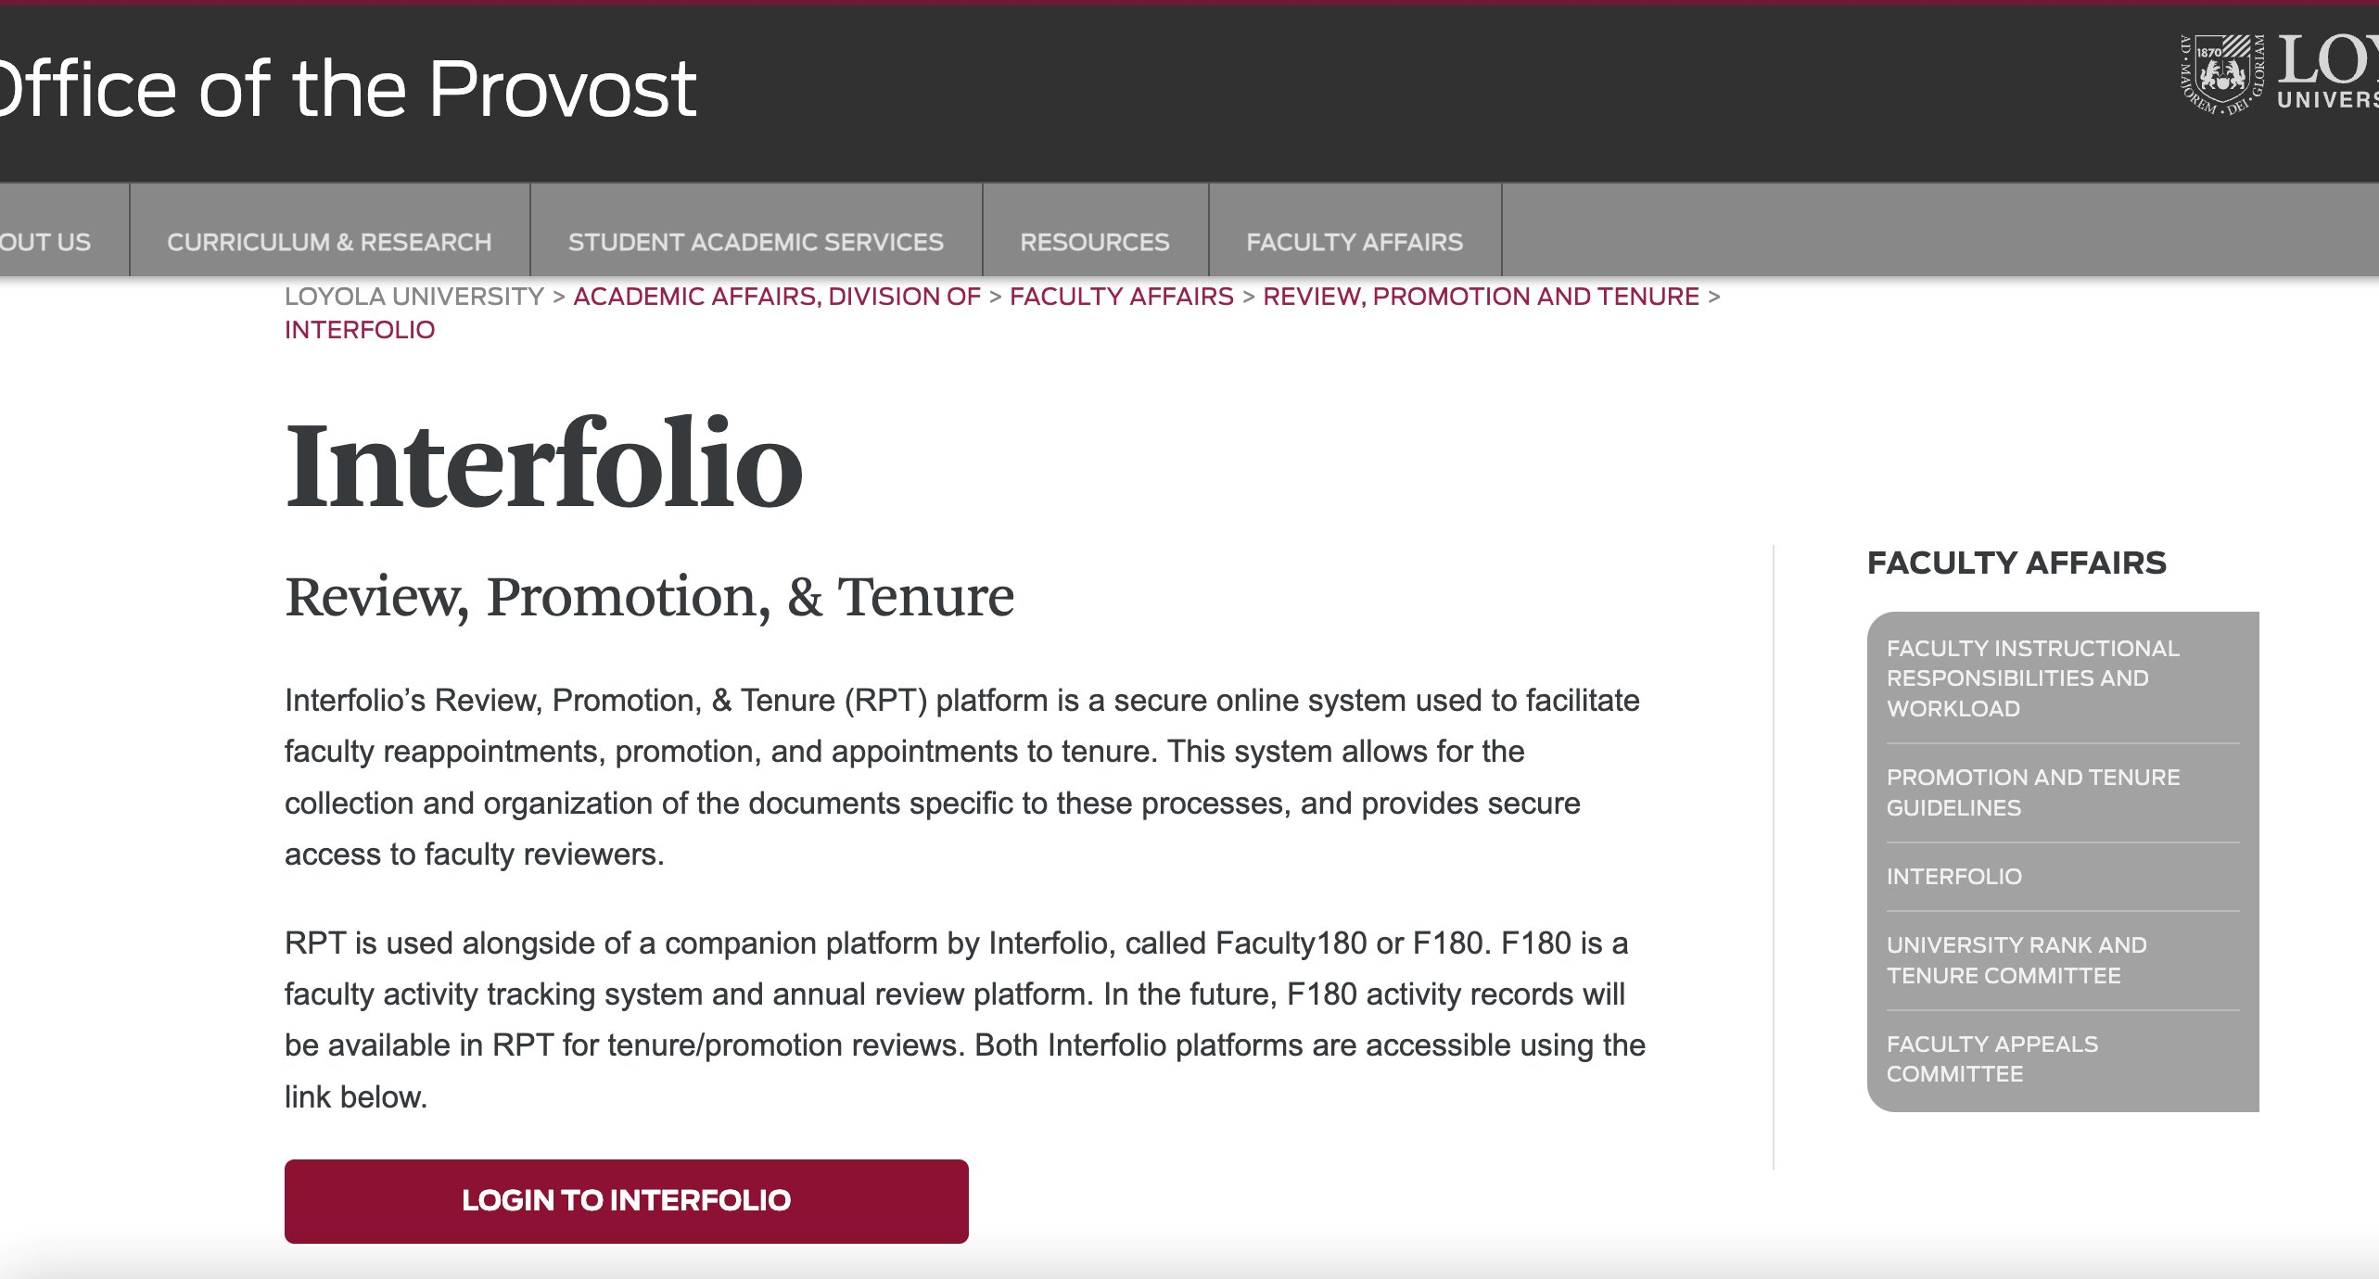
Loyola's Interfolio Support Website

Slide 19
Contacts
Michelle Pencyla, M.Ed.
Assistant Provost, Faculty Administration, Health Sciences Campus Office mpencyla@luc.edu
Julia Elsky, Ph.D.
Associate Director of Faculty Affairs;
Associate Professor, Department of Modern Languages & Literatures
jelsky@luc.edu

